Slide 1
CAU-IIKH
Interactive Intelligent Kitchen Helper
20182705 고주형 20185784 김호성
20182610 손희승 20162874 이준협
20142611 이하람

Slide 2
What “IIKH” is
IIKH
Recipe Name
Description of Recipe
Needed Ingredients
Recipe
Plan Name
Meal Plan of Breakfast Lunch Dinner
Plan
“Convenience”
of Kitchen User
Management

Slide 3


Cream Pasta Recipe ~~~~~~~~~~~ ~~~~~~~~~~~ ~~~~~~~ ~~~~~~~~~
Steak Recipe ~~~~~~~~~~~ ~~~~~~~~~~~ ~~~~~~~ ~~~~~~~~~
Fried Chicken Recipe ~~~~~~~~~~~ ~~~~~~~~~~~ ~~~~~~~ ~~~~~~~~~
Lamb Curry Recipe ~~~~~~~~~~~ ~~~~~~~~~~~ ~~~~~~~ ~~~~~~~~~
Soup Recipe ~~~~~~~~~~~ ~~~~~~~~~~~ ~~~~~~~ ~~~~~~~~~
Curry Recipe ~~~~~~~~~~~ ~~~~~~~~~~~ ~~~~~~~ ~~~~~~~~~
Steak Recipe ~~~~~~~~~~~ ~~~~~~~~~~~ ~~~~~~~ ~~~~~~~~~
Garlic Soup Recipe ~~~~~~~~~~~ ~~~~~~~~~~~ ~~~~~~~ ~~~~~~~~~
Onion Soup Recipe ~~~~~~~~~~~ ~~~~~~~~~~~ ~~~~~~~ ~~~~~~~~~

Slide 4

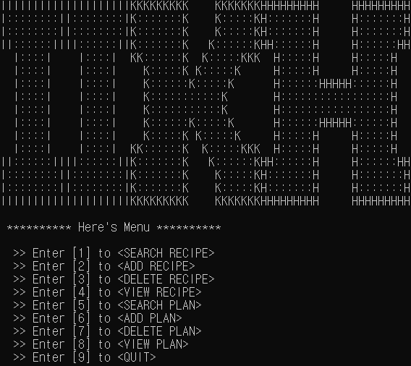
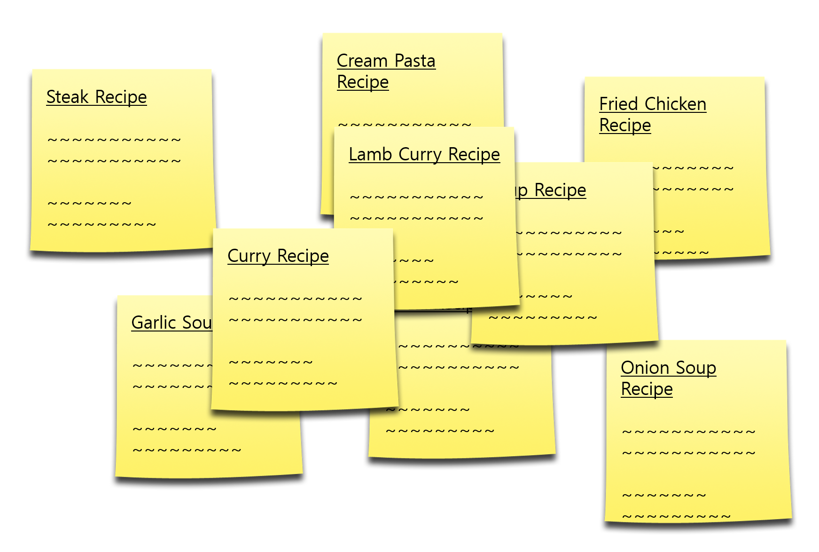

Slide 5
What we focused on
“UX”

Slide 6
“UX”
Console…
Excel…
Hard to type
Easy to type
Hard to edit after Entering
Easy to edit after Entering
Hard to see what I have entered
Easy to see what I have entered
Hard to do task at the same time. - Adding Recipe & Editing Ingredient
Easy to edit every cell at the same time

Slide 7

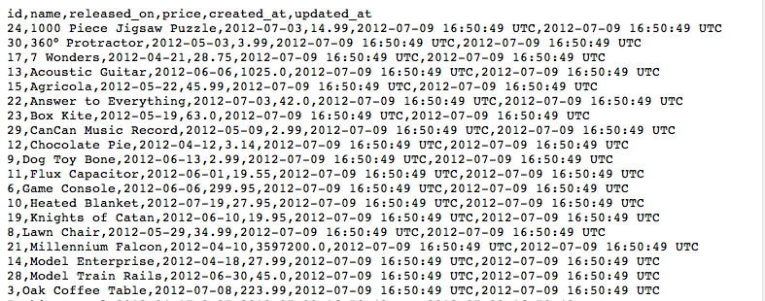
CSV
Comma Separated Values

Slide 8
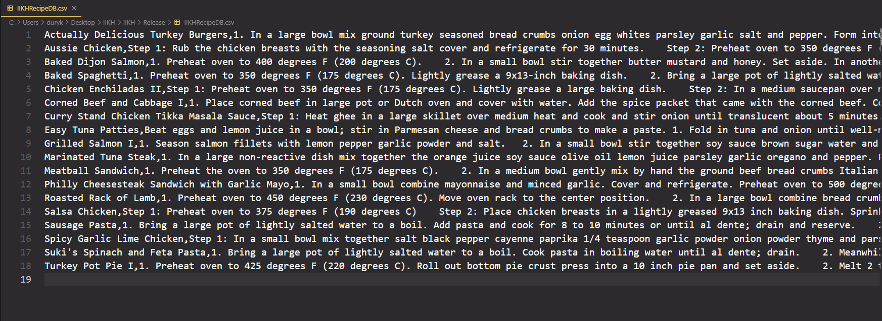
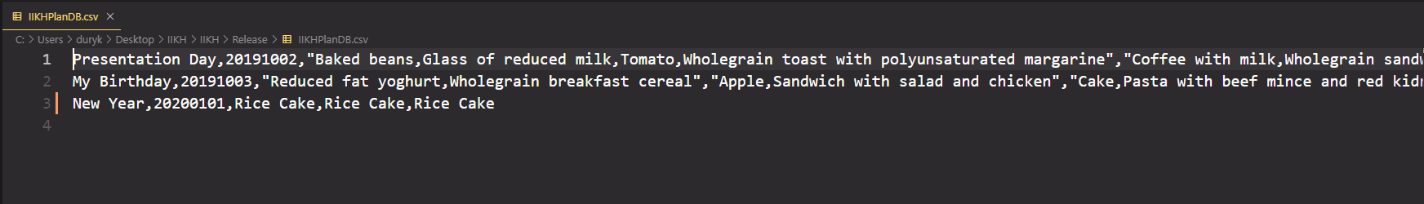
CSV
Recipe Database
Plan Database

Slide 9
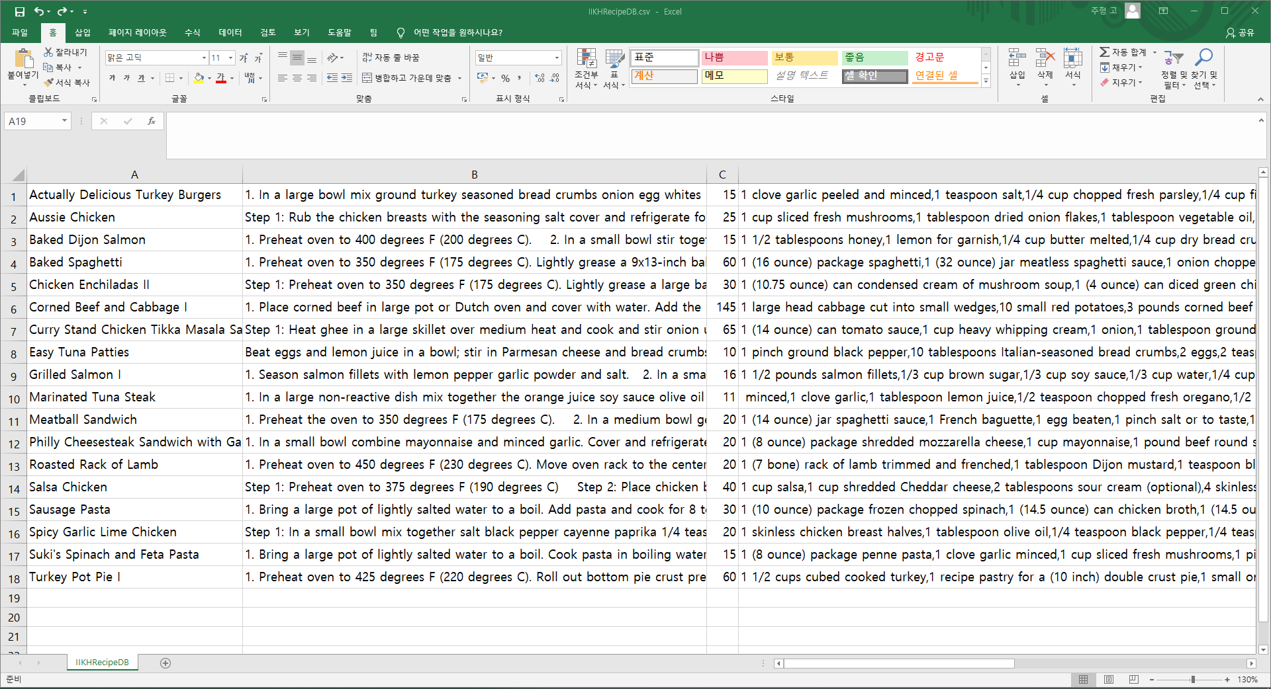
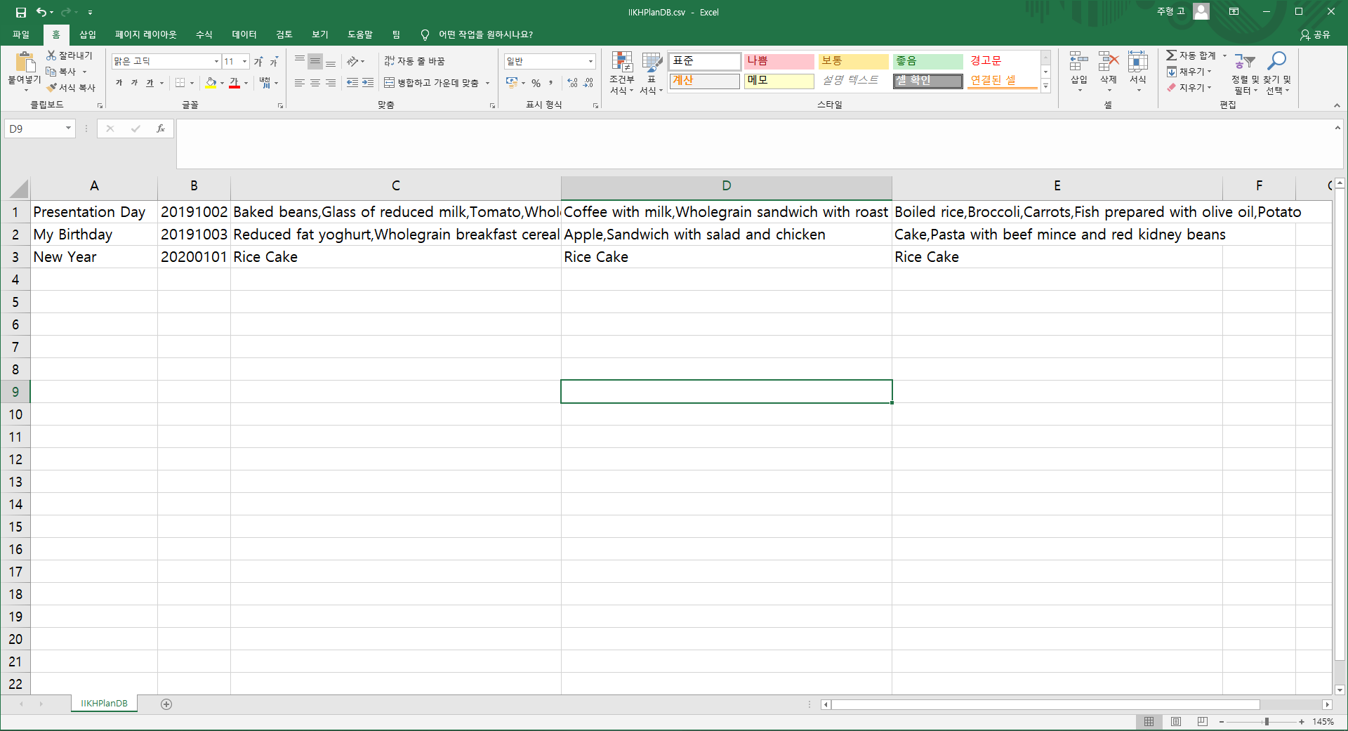
CSV in Excel
Recipe Database
Plan Database

Slide 10
Process of IIKH Project

Slide 11
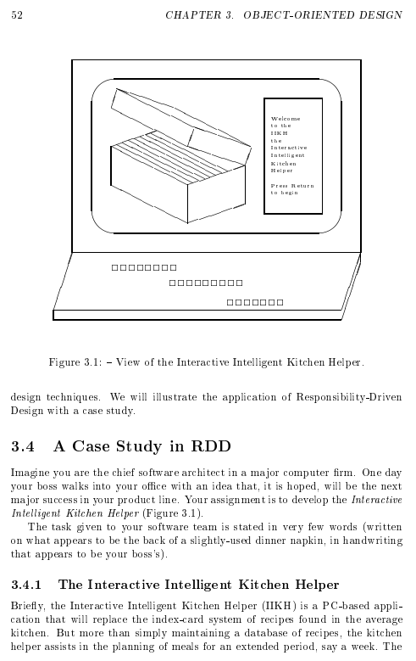
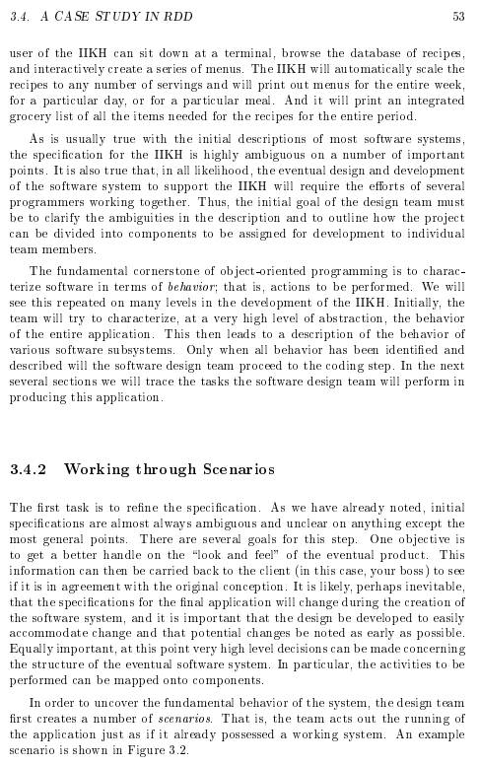
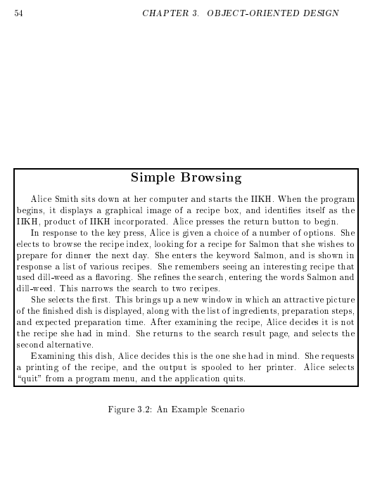
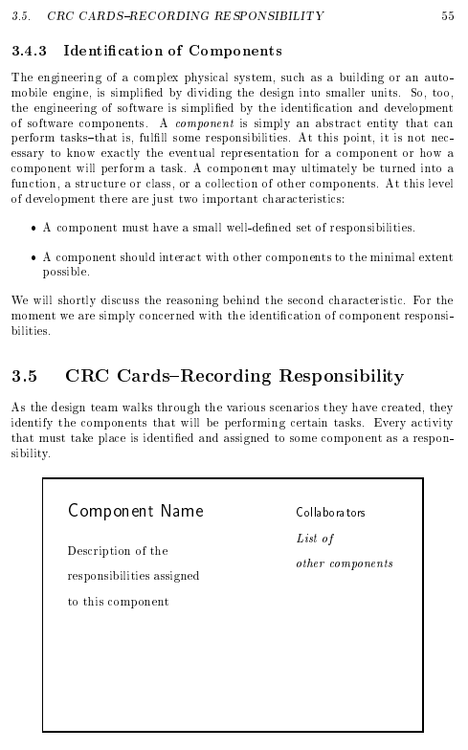
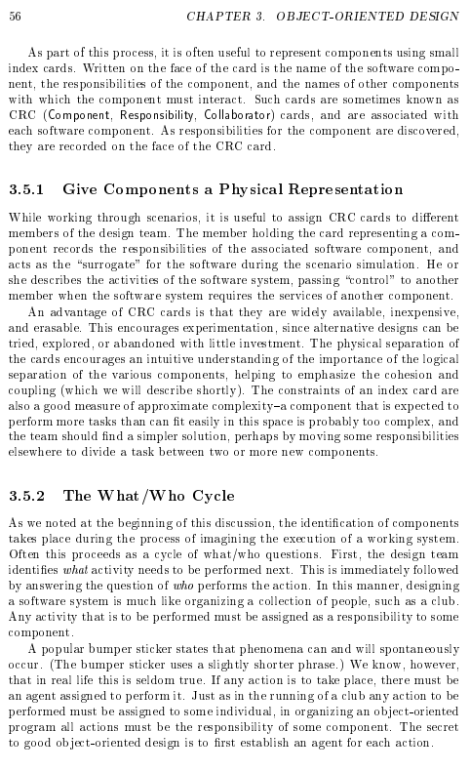
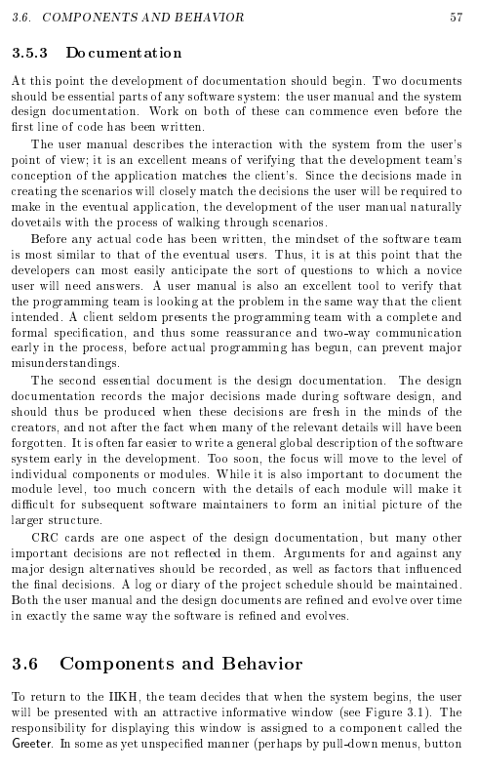
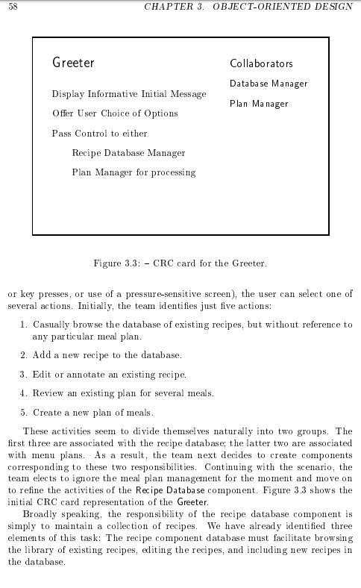
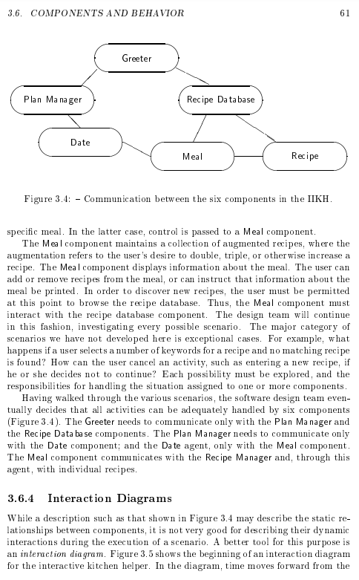
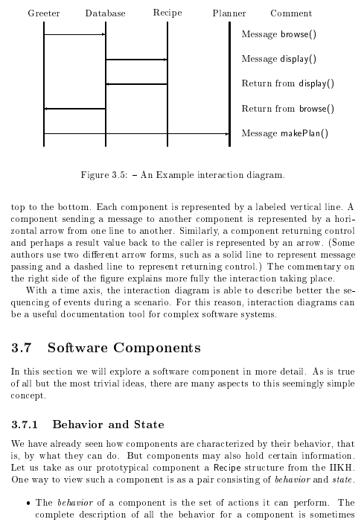
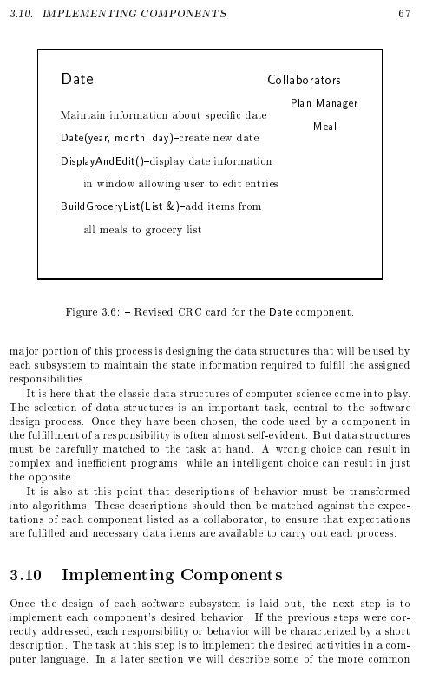
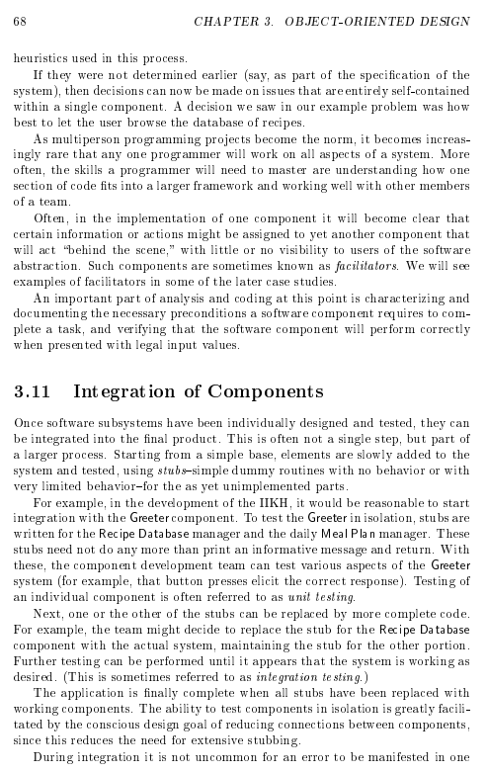
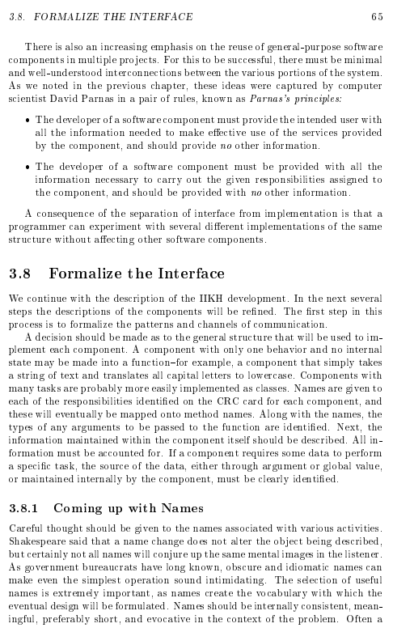
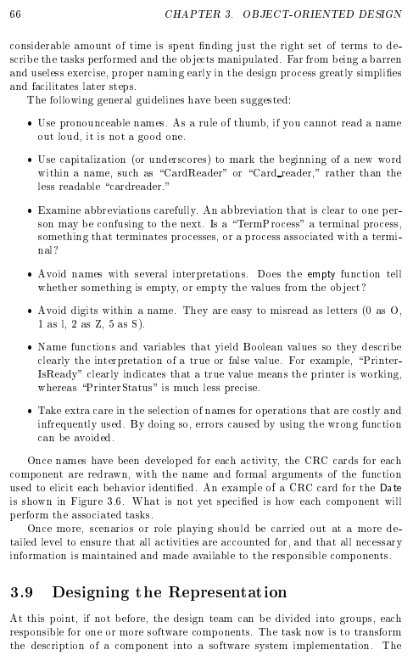
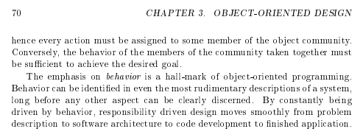
What is our Task?
Specification was ambiguous

Slide 12
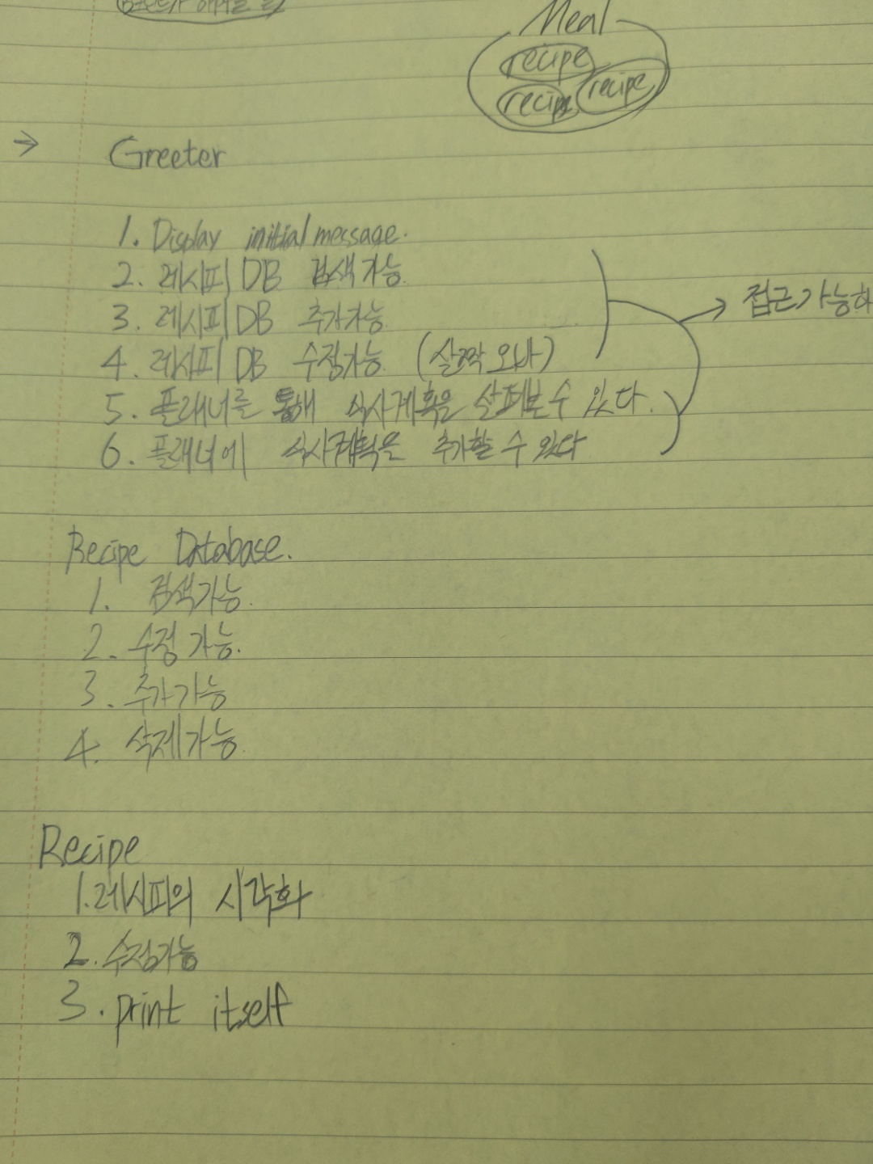
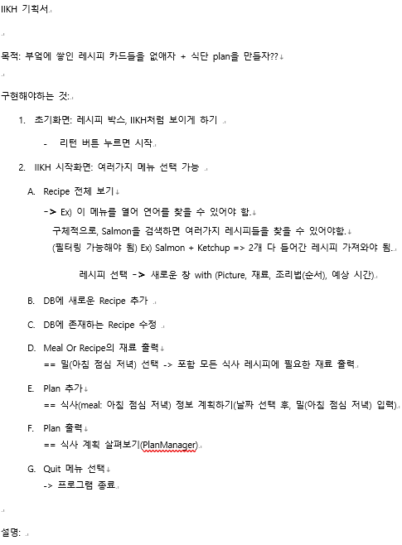
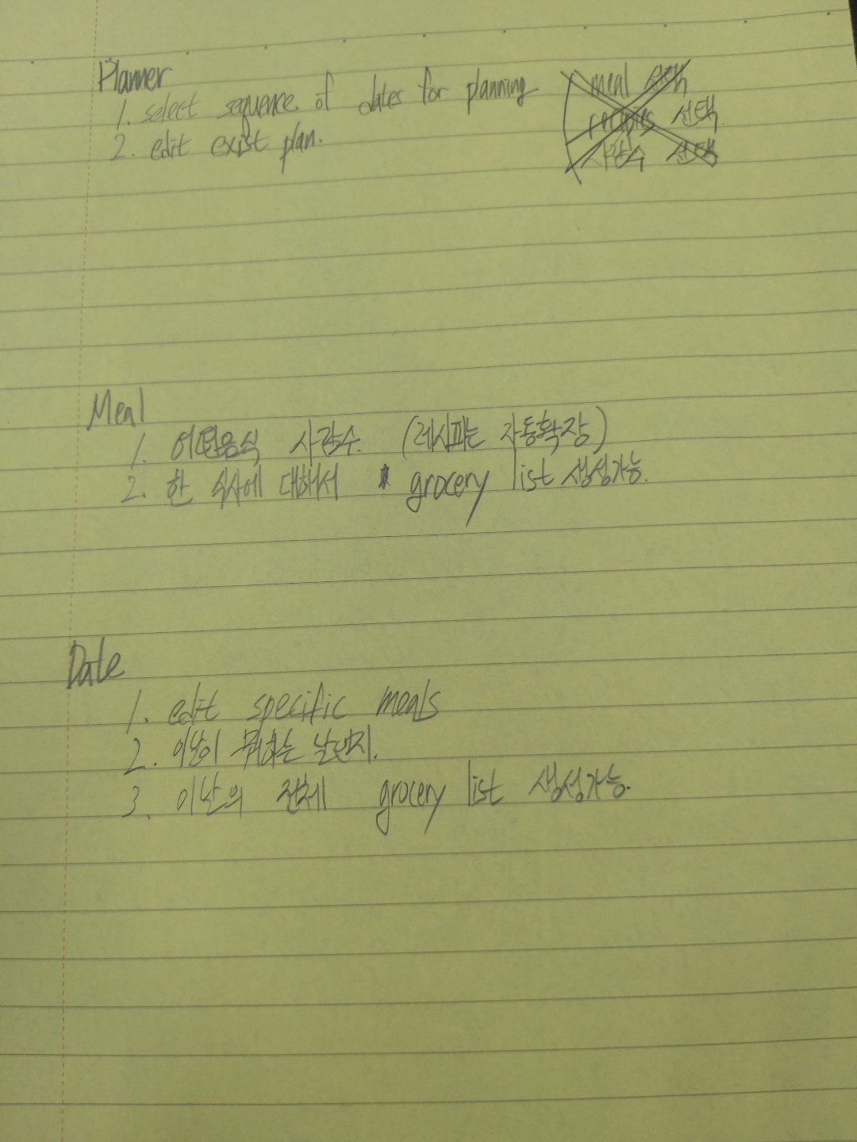
What we did
Refine Specification

Slide 13
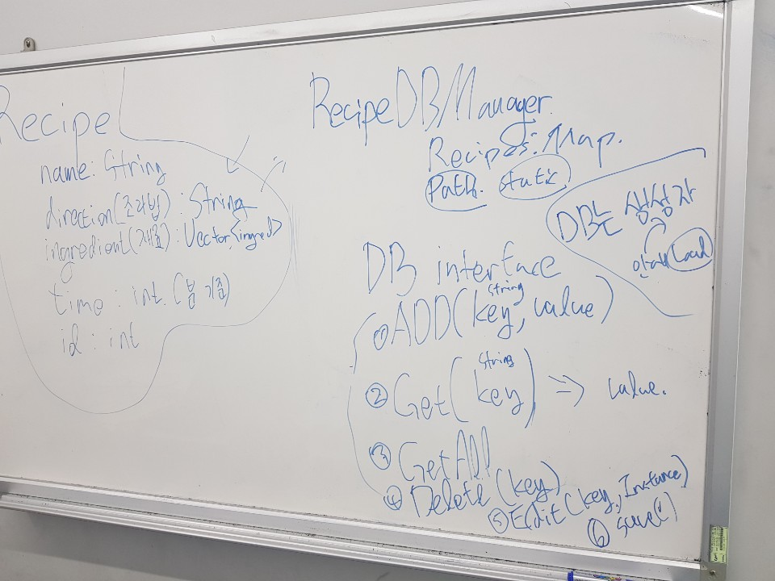
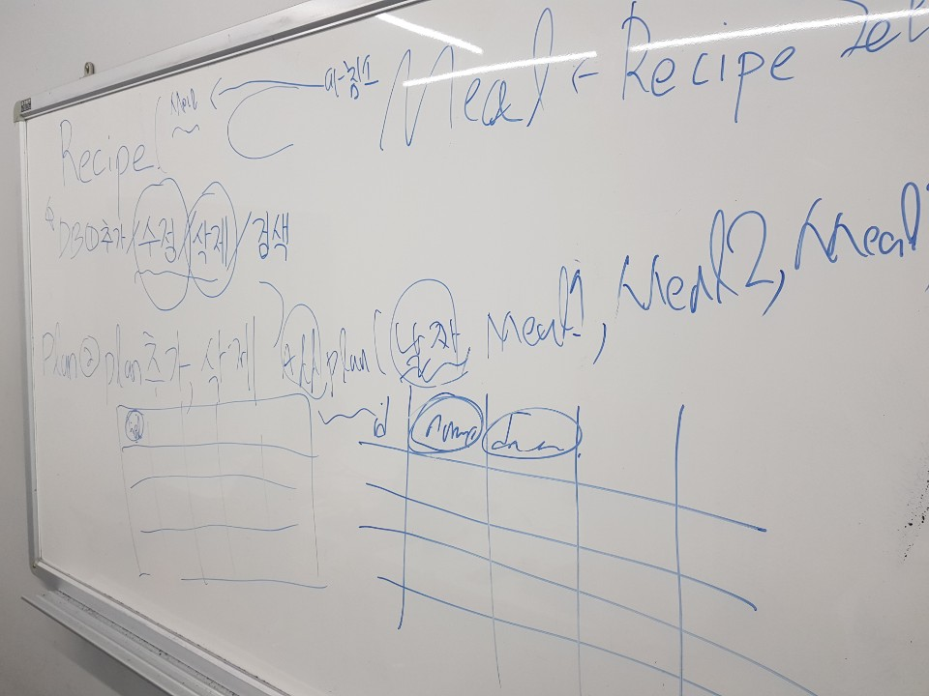
What we did
Identifying the Components

Slide 14
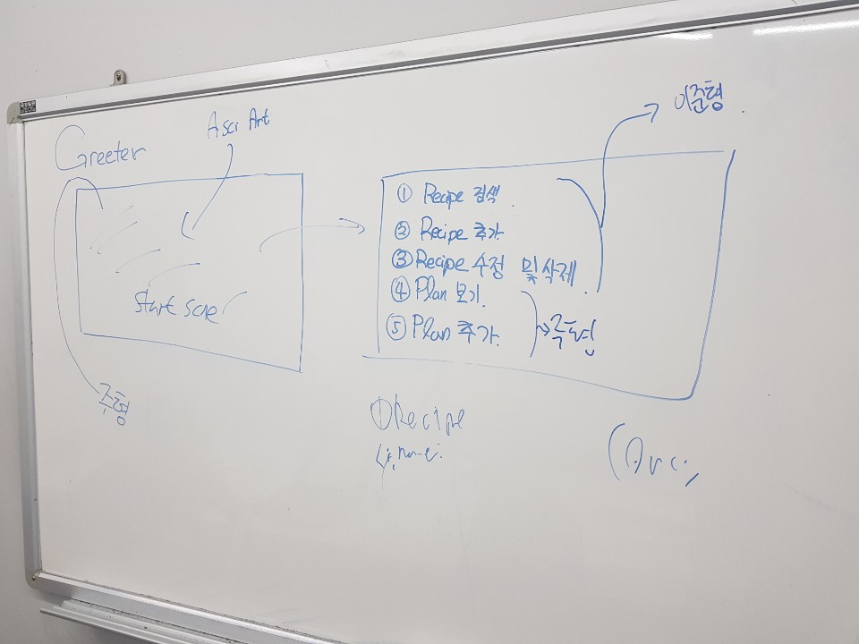
What we did
Refine Specification
Identifying the Components

Slide 15
Components we needed
What we did
Greeter
User Interface
“Design of Components”
CSV Parser
Inner Structure
“Whose Responsibility is it?”
Read csv file Write csv files
Process Data Manage Database (PlanDB/RecipeDB)
Handle Exception

Slide 16
What we did
UML

Slide 17
Encapsulation
CSV Parser
Inner Structure
Greeter
Private
Public
Public
Private
Public
Public
Private
Hidden
read()
write()
_save()
recipesDB
plansDB
Hidden
_search() _delete() showAll()
<Menu>
Hidden
Communicate
Communicate

Slide 18
Functionality
Search Recipe
Add Recipe
Delete Recipe
View Recipe
Search Plan
Add Plan
Delete Plan
View Plan
Quit

Slide 19
DEMO Time

Slide 20
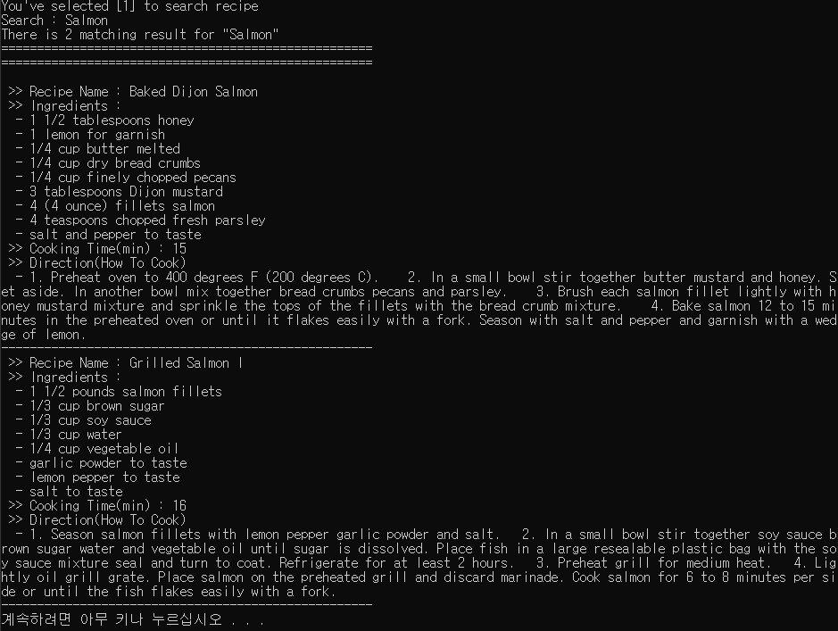
1. Search Recipe
Search Keyword “Salmon”

Slide 21
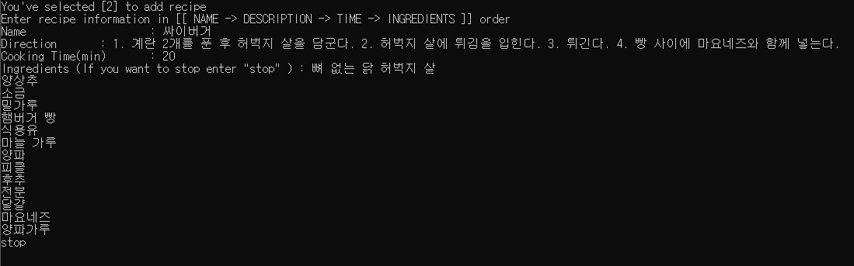
2. Add Recipe
Let’s add “Thigh Burger Recipe”

Slide 22
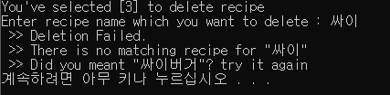
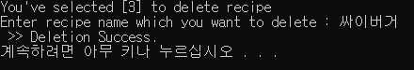
3. Delete Recipe
Let’s Delete “Thigh Burger”
Invalid Deletion
Valid Deletion

Slide 23
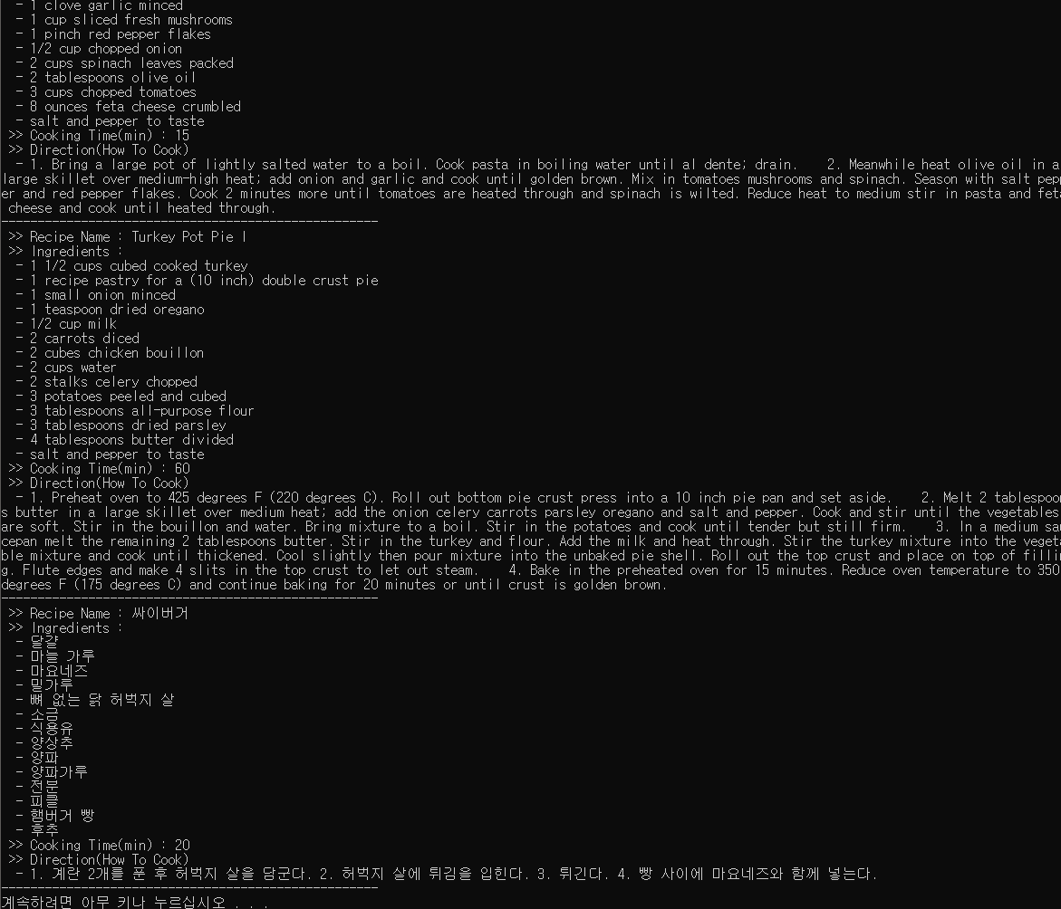
4. View Recipe
Prints Recipes in alphabetical order

Slide 24
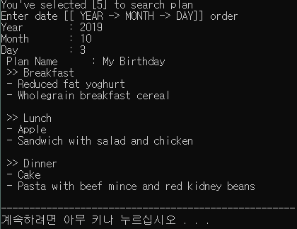
5. Search Plan
Search Plan by date

Slide 25
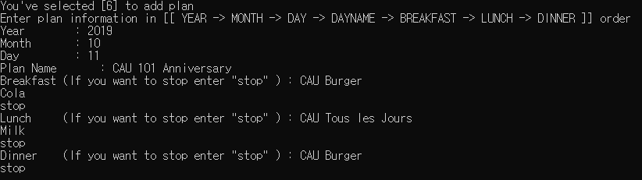
6. Add Plan
Let’s add “CAU Anniversary Meal Plan”

Slide 26
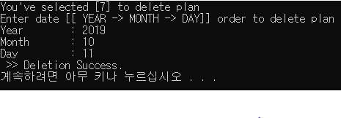
7. Delete Plan
Let’s Delete “CAU Anniversary Meal Plan”

Slide 27
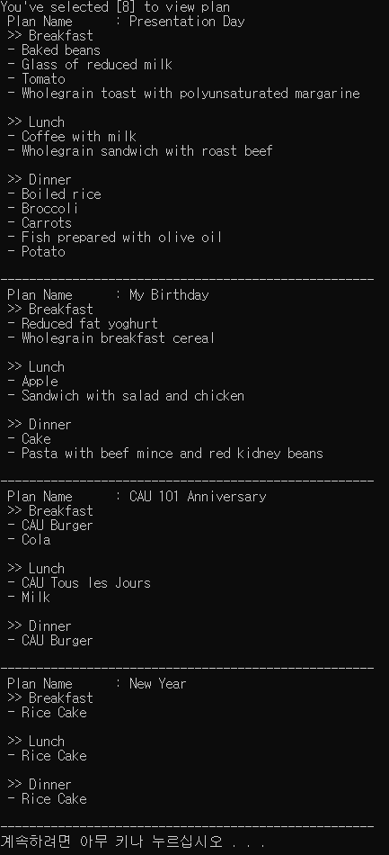
8. View Plan
Prints Plans in upcoming order

Slide 28
9. Quit
Exit Program

Slide 29
Thank You

